Slide 1

Submitting Coding Assignments Through Gradescope
[CPS 2231 Tutorial]
Author: Joseph “Jay” Tomasello
Organization: Kean University

Slide 2
Submitting Student Code

Slide 3
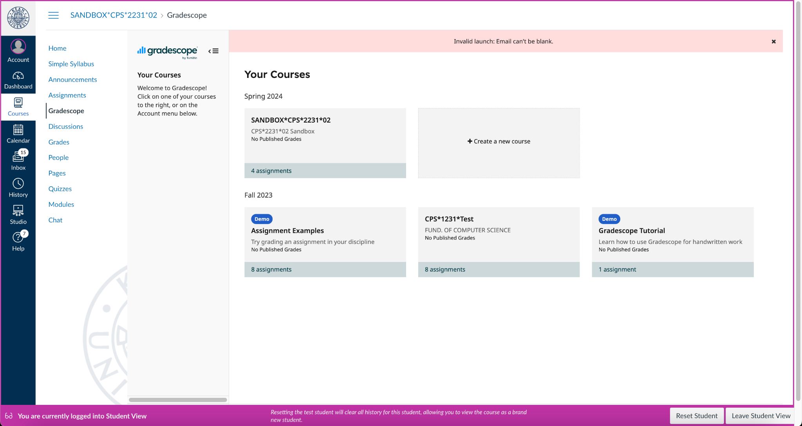
Step 1: Finding a Gradescope Assignment in Canvas
a) NOTICE:
Programming assignments in Gradescope can be found under the “Gradescope” tab

Slide 4
Step 2: Selecting the Matching Course
b) CLICK:
Students select the appropriate course for the assignment they need to submit

Slide 5
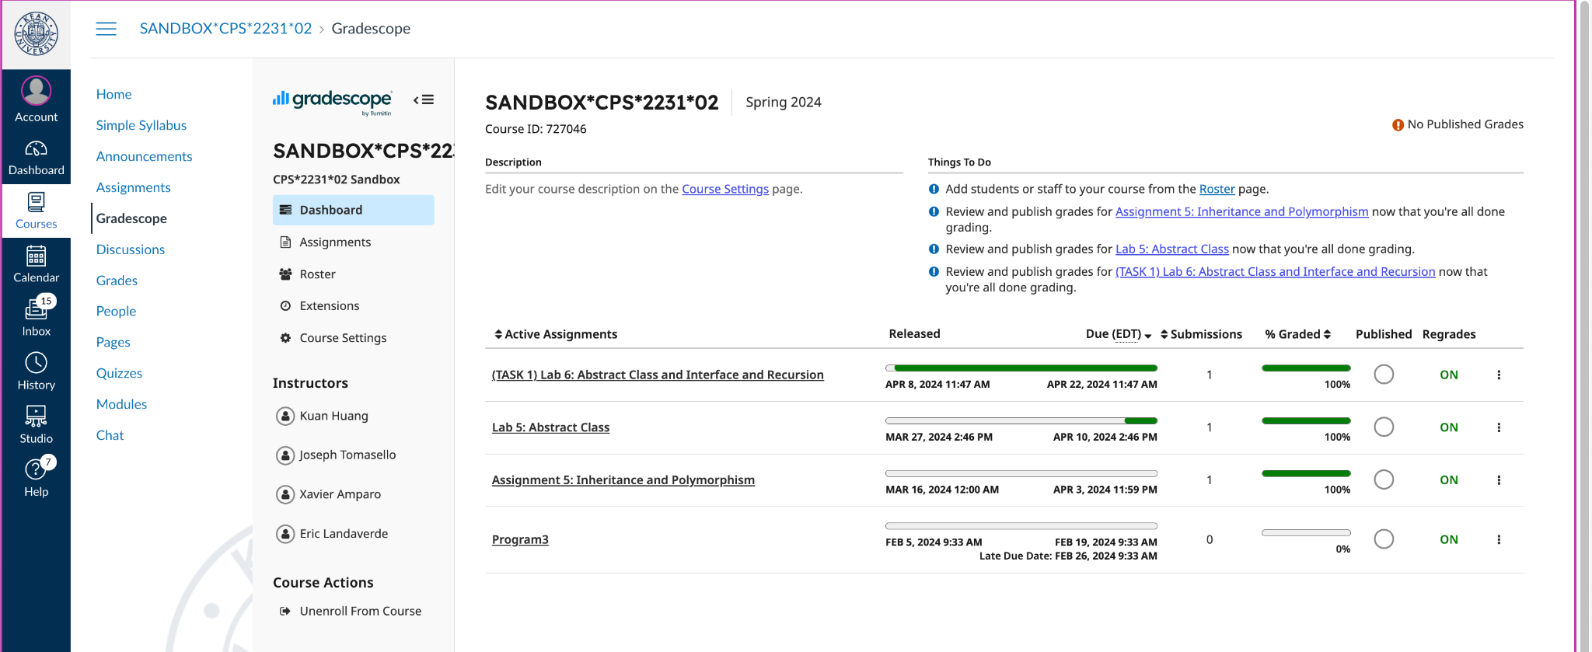
Step 3: Selecting the Matching Assignment
c) CLICK:
Students select the assignment in Gradescope

Slide 6
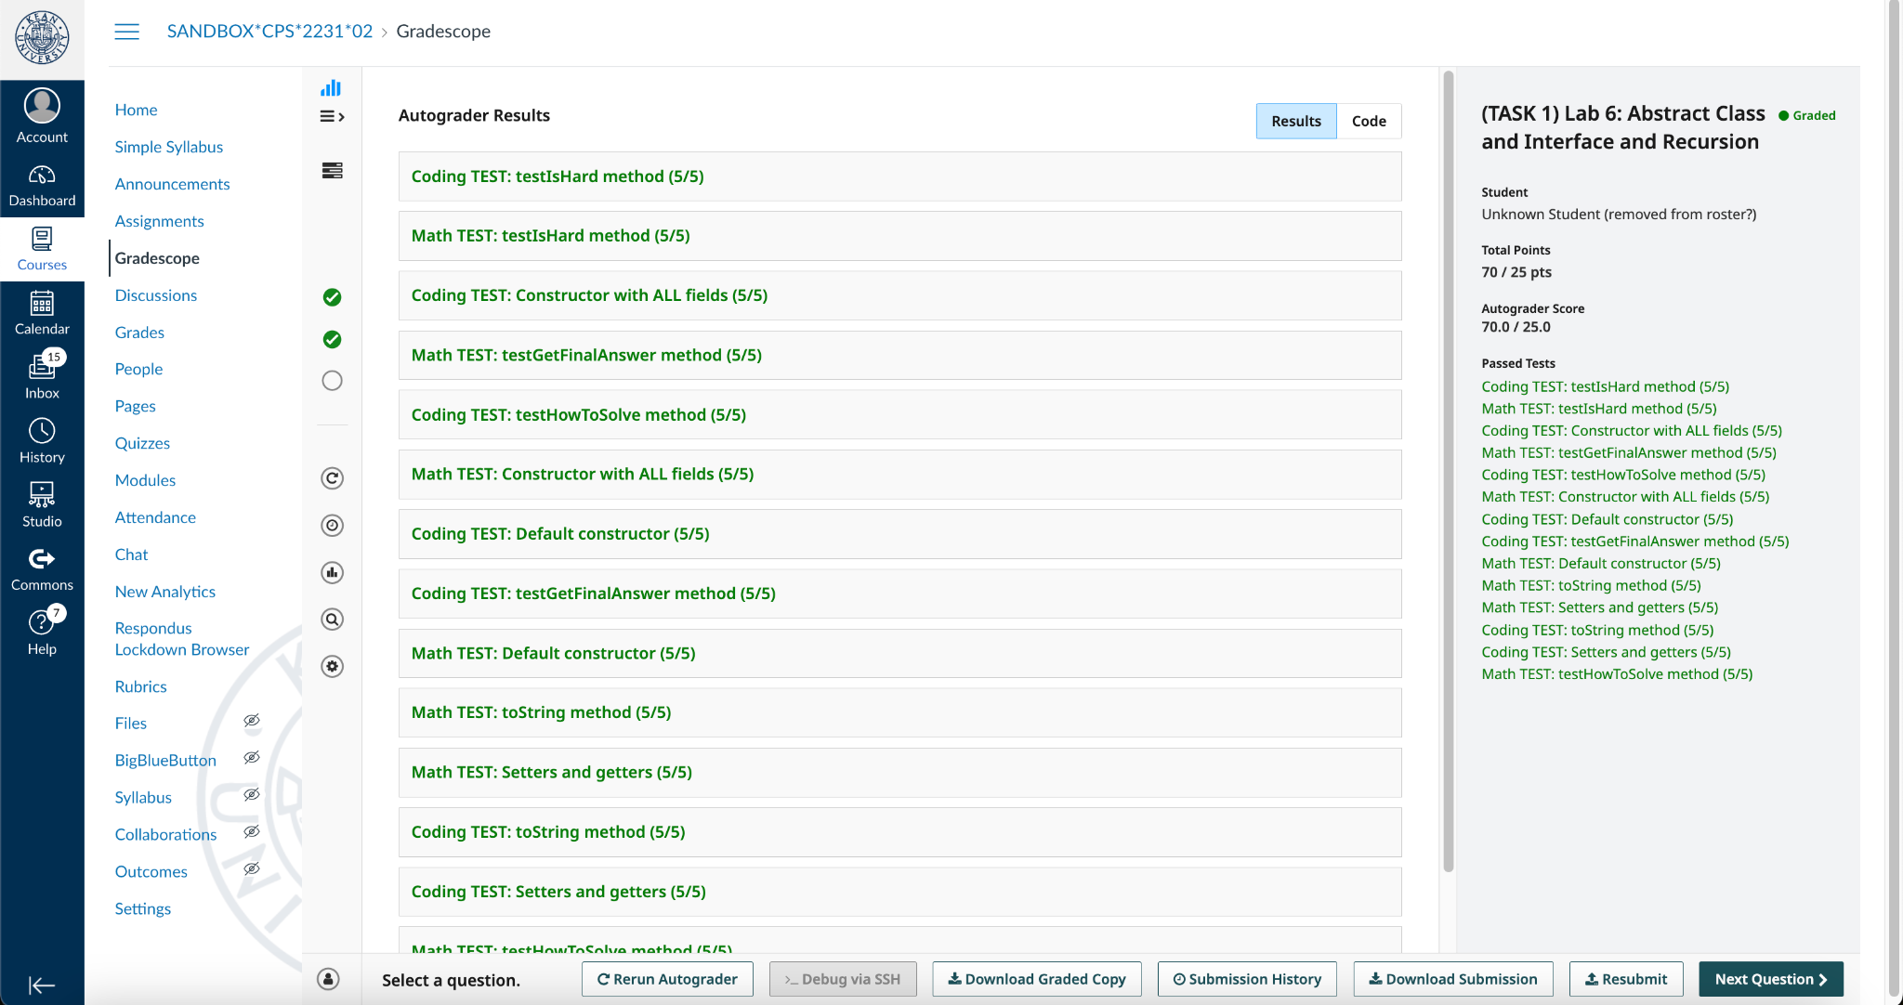
Step 4: Review Feedback

